Slide 1
Connect Four Bot using
Reinforcement Learning
Team Members:
Anupama Anupama
Harshini Muthukrishnan
Prashil Bhimani
Santosh ALN

Slide 2
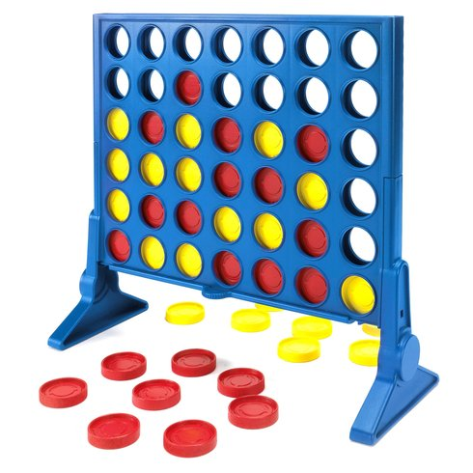
About the project
Games form one of the most important learning curve in developing a child’s intelligence
Human brain learns from experience and develop a strategy to learn
This type of learning is known as reinforcement learning
Reinforcement learning is learning to analyze a current state and take an action that maximizes a future reward, through continuous interaction.
Develop a bot to play Connect 4 game using reinforcement learning

Slide 3
Possible Approaches
Using Neural Networks to decide on a policy
Temporal difference learning (TDL), a well-known variant of the reinforcement learning
N- tuple network to develop policy lasting over moves

Slide 4
Thank You

